Slide 1
Design and Analysis of Algorithms
Algorithms-II : CS345A
Website: hello.iitk.ac.in
Lecture 2
Divide and Conquer Paradigm - II

Slide 2
Recap from Lecture 1

Slide 3
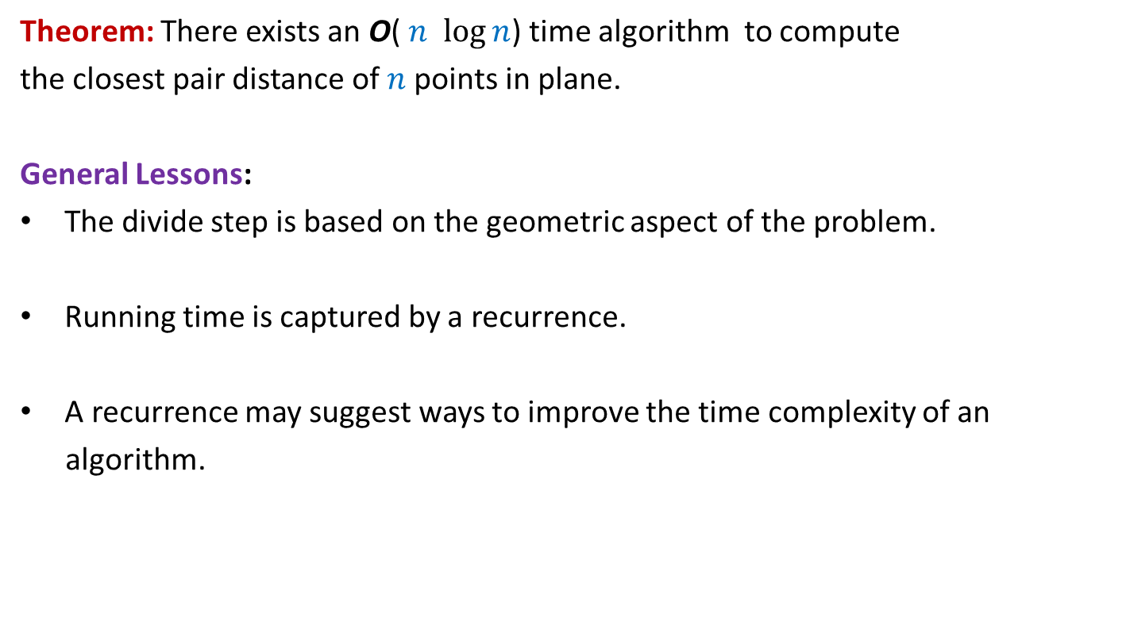
Theorem: There exists an O( $n$ $\log{n}$) time algorithm to compute
the closest pair distance of $n$points in plane.
General Lessons:
The divide step is based on the geometric aspect of the problem.
Running time is captured by a recurrence.
A recurrence may suggest ways to improve the time complexity of an
algorithm.

Slide 4
problem 2
Non-dominated Points

Slide 5





The Non-Dominated Points
y
Definition: point $p$ is said to dominate point $q$ if
x($p$) > x($q$)
and y($p$) > y($q$)
$$p$$
$$q$$
$$q$$
$$(0,0)$$
x

Slide 6
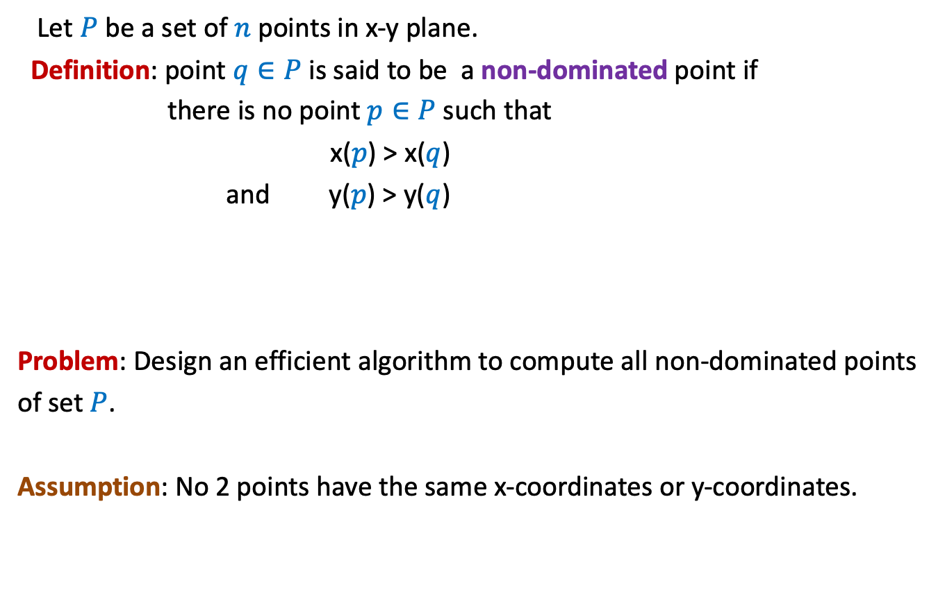
The Non-Dominated Points
Let $P$ be a set of $n$ points in x-y plane.
Definition: point $q∈P$ is said to be a non-dominated point if
there is no point $p∈P$ such that
x($p$) > x($q$)
and y($p$) > y($q$)
Problem: Design an efficient algorithm to compute all non-dominated points
of set $P$.
Assumption: No 2 points have the same x-coordinates or y-coordinates.

Slide 7


The Non-Dominated Points
y
$$q$$
$$p$$
$$(0,0)$$
x

Slide 8
The Non-Dominated Points
y
A staircase structure ☺
$$(0,0)$$
x

Slide 9

The Non-Dominated Points
Let $P$ be a set of $n$ points in x-y plane.
A simpler problem:
Design an efficient algorithm to report any non-dominated point from $P$.

Slide 10

The Non-Dominated Points
y
O($n$) time
$$(0,0)$$
x

Slide 11
A simple algorithm for all non-dominated points

Slide 12
A Simple Algorithm
y
$$(0,0)$$
x

Slide 13



A Simple Algorithm
y
$h$ : no. of non-dominated points
Time complexity =
O($n^{2}$) ?
O($nh$)
$$(0,0)$$
x

Slide 14
A Divide and Conquer algorithm

Slide 15



The Divide step
y
O($n$) time
$$(0,0)$$
x
Left half set
$⌈\frac{n}{2}⌉$points
$⌊\frac{n}{2}⌋$points
Right half set

Slide 16

Solving the Subproblems recursively
y
2 T($\frac{n}{2}$) time
$$(0,0)$$
x
Left half set
$⌈\frac{n}{2}⌉$points
$⌊\frac{n}{2}⌋$points
Right half set

Slide 17

The conquer step
y
O($n$) time
$$p$$
$$(0,0)$$
x
Left half set
$⌈\frac{n}{2}⌉$points
$⌊\frac{n}{2}⌋$points
Right half set

Slide 18


The time complexity of the algorithm
y
T($n$) = c $n$ + 2 T($n$/2)
Time complexity =
O($n$ $\log{ n}$)
$$(0,0)$$
x
Left half set
$⌈\frac{n}{2}⌉$points
$⌊\frac{n}{2}⌋$points
Right half set

Slide 19
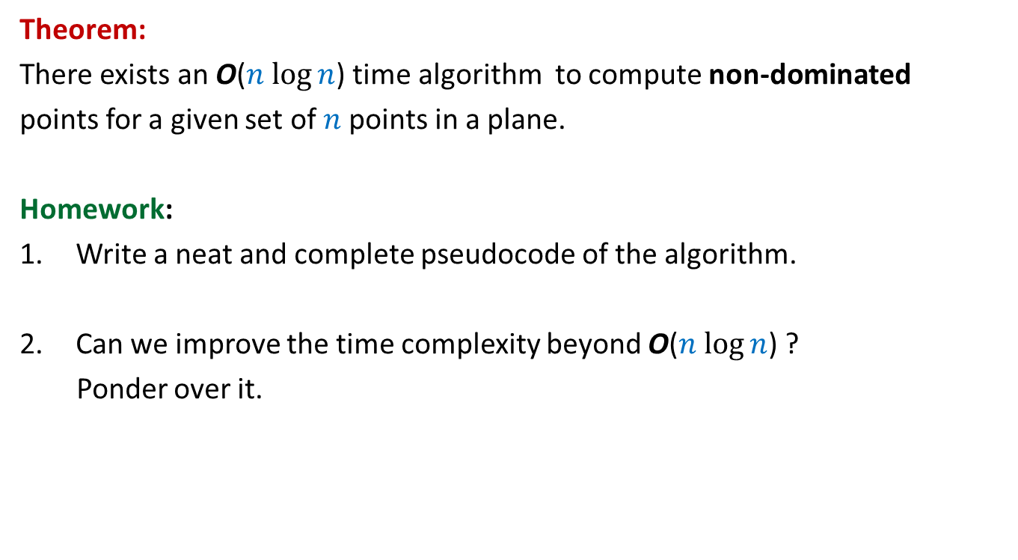
Theorem:
There exists an O($n$ $\log{n}$) time algorithm to compute non-dominated
points for a given set of $n$points in a plane.
Homework:
Write a neat and complete pseudocode of the algorithm.
Can we improve the time complexity beyond O($n$ $\log{n}$) ?
Ponder over it.

Slide 20
problem 3
Convex Hull

Slide 21


A Convex Polygon
Definition: A polygon is convex if for any two points belonging to the polygon,
the line segment joining them is inside the polygon.
$p$
$q$

Slide 22
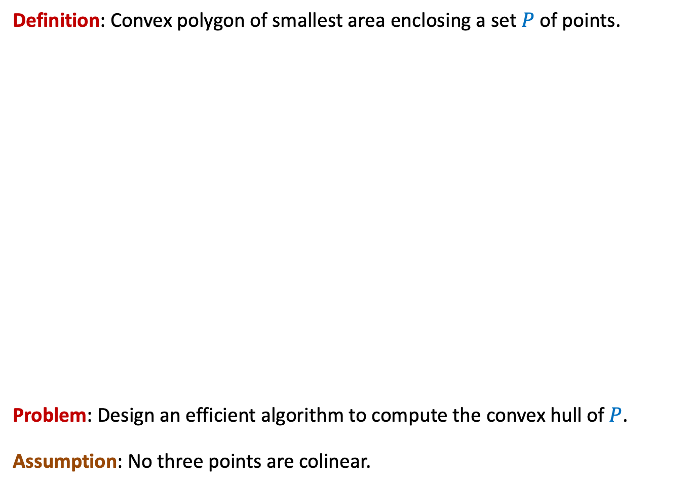
Convex hull
Definition: Convex polygon of smallest area enclosing a set $P$ of points.
Problem: Design an efficient algorithm to compute the convex hull of $P$.
Assumption: No three points are colinear.

Slide 23

Tool 1
Let $A⊆P$.
Convex Hull of $A$ must be fully contained inside the convex hull of $P$.

Slide 24



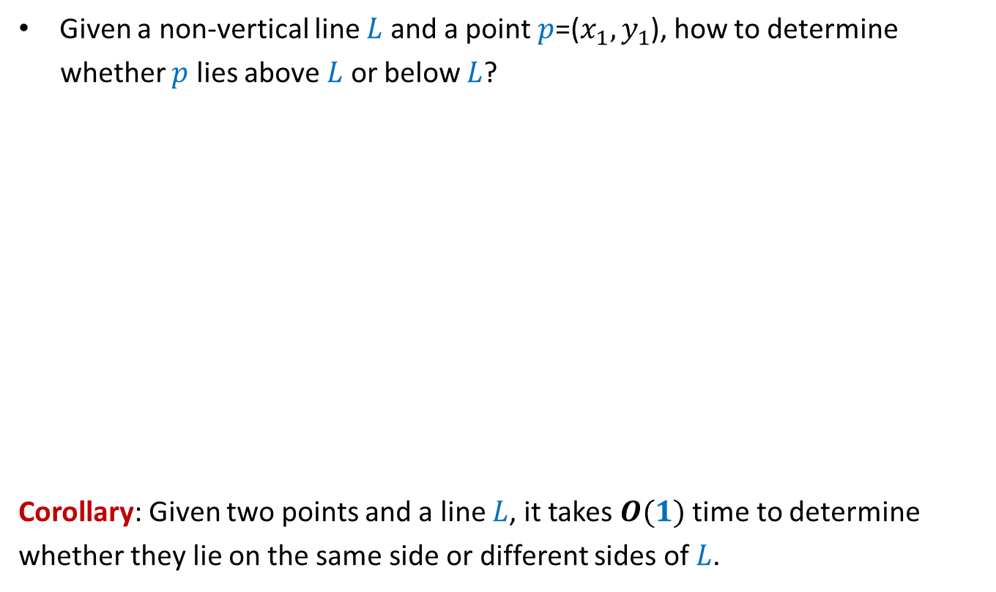

Tool 2
Given a non-vertical line $L$ and a point $p$=($x_{1},y_{1}$), how to determine
whether $p$ lies above $L$ or below $L$?
Corollary: Given two points and a line $L$, it takes $O(1)$ time to determine
whether they lie on the same side or different sides of $L$.
$O(1)$ time
$$q=(a_{1},b_{1})$$
$$y=mx+c$$
$$r=(a_{2},b_{2})$$

Slide 25

The Divide Step
O($n$) time
Left half set
$⌈\frac{n}{2}⌉$points
$⌊\frac{n}{2}⌋$points
Right half set

Slide 26

Solving the subproblems recursively
2 T($\frac{n}{2}$) time
Left half set
$⌈\frac{n}{2}⌉$points
$⌊\frac{n}{2}⌋$points
Right half set

Slide 27
The Conquer step
Left half set
$⌈\frac{n}{2}⌉$points
$⌊\frac{n}{2}⌋$points
Right half set

Slide 28
The Conquer step
Left half set
$⌈\frac{n}{2}⌉$points
$⌊\frac{n}{2}⌋$points
Right half set

Slide 29
A simpler problem
The right half set is a point

Slide 30

The right half set is a point
$$p$$

Slide 31


The right half set is a point
$$q$$
Tool 1
Upper tangent
$$p$$
Lower tangent
$$r$$

Slide 32

Homework
Make sincere attempts to design an efficient algorithm to find the upper tangent and lower tangent from $p$.

